Slide 1
Final Presentation
26 August 2022
Arunima Roy, Sohrab Rajabi , and Tamlyn Tamura
Notes:
Tamlyn

Slide 2
What to Expect:
Problem Statement
Literature Review
Description of Data
Data Preprocessing
Models and Evaluations
Interpretations and Analysis
Discussion
Conclusion
Notes:
Tamlyn

Slide 3
Problem Statement
Primary Objective:
Break down chemical consumption data by organization
Secondary Objective:
Predict chemical consumption by organizations over the next 5 years using a classification algorithm
Final Objective:
Predict chemical consumption over the next 5 years using a forecasting algorithm
Create a visual dashboard to summarize analysis and forecasting analysis
Notes:
Tamlyn

Slide 4
Literature Review
ARIMA Model – Complete Guide to Time Series Forecasting in Python:
3 parameters – AR(p), MA(q), and I(d)
Data must be stationary to apply this type of model
Use ADfuller test to check
Apply differencing method until data is stationary (p-value < 0.05)
Notes:
Tamlyn

Slide 5
Literature Review
Complete Guide to SARIMAX in Python for Time Series Modeling
Can handle seasonality
Can look at exogenous factors if they appear in a cyclical way
Other models cannot do this
Ex. Temperatures are higher in the summer and lower in the winter, and humidity (an exogenous factor) plays a role in temperature
Ended up using a SARIMA model because we did not look at exogenous factors
Notes:
Tamlyn

Slide 6
Data Preprocessing – Chemical Consumption
Chemical Consumption data frames included two (.parquet) files included total 1,387,196 observations.
The "pyarrow" engine needs to be installed regarding read (.parquet) files.
Separate functions developed to read each file and return both general info and new files in .CSV format
Scenario I: Remove duplicates in each file separately, then choose similar columns, concatenate files, and finally, remove null values.
Scenario II: Choose similar columns between two data frames then concatenate files, Remove duplicates, and finally, remove null values.
 | # of Observations | Data Frame Shape | Share From Total
File #1 | 1,173,749 | (1173749, 32)
File #2 | 213,447 | (213447, 24)
Scenario I | 1,177,217 | (1177217, 9) | 84.84 %
Scenario II | 1,139,776 | (1139776, 9) | 82.16 %
Notes:
Arunima

Slide 7
Description of Data
For our final objective, we used the parquet files containing the chemical data.
Total Observations: 1,177,217
Variable Name
TO_LOCATION
Part
TRANSACTION_DATE
TRADE_NAME
SDS_Number
Document_Spec
Year
Specific_gravity
Usage_gallons
Notes:
Arunima

Slide 8
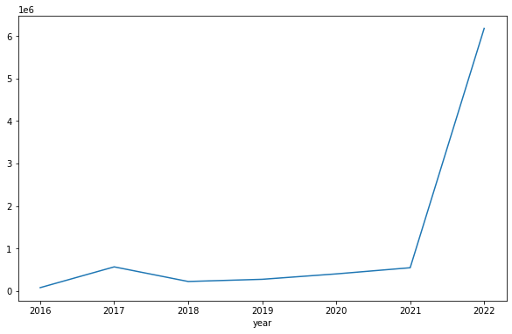
Data Preprocessing – Basic EDA
Wanted to understand our final dataset a bit more and the information that we had to use for forecasting
Usage Gallons per Year:
- Dataset is between the years of 2016 – 2022
- Increase in chemical usage in 2021
- Could be due to increase in deliveries and Boeing's sustainability effort to creating composites made of recycled materials
Notes:
Arunima

Slide 9
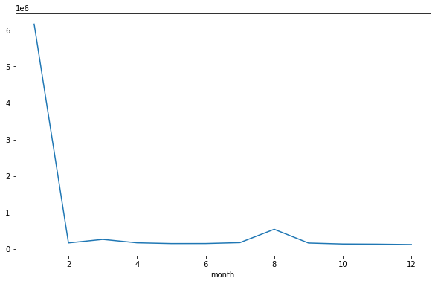
Data Preprocessing – Basic EDA
Usage Gallons Grouped by Month:
There are more increases in usage in the beginning of the year (month 1) and then spikes again in the middle of the year (month 8)
Notes:
Arunima

Slide 10
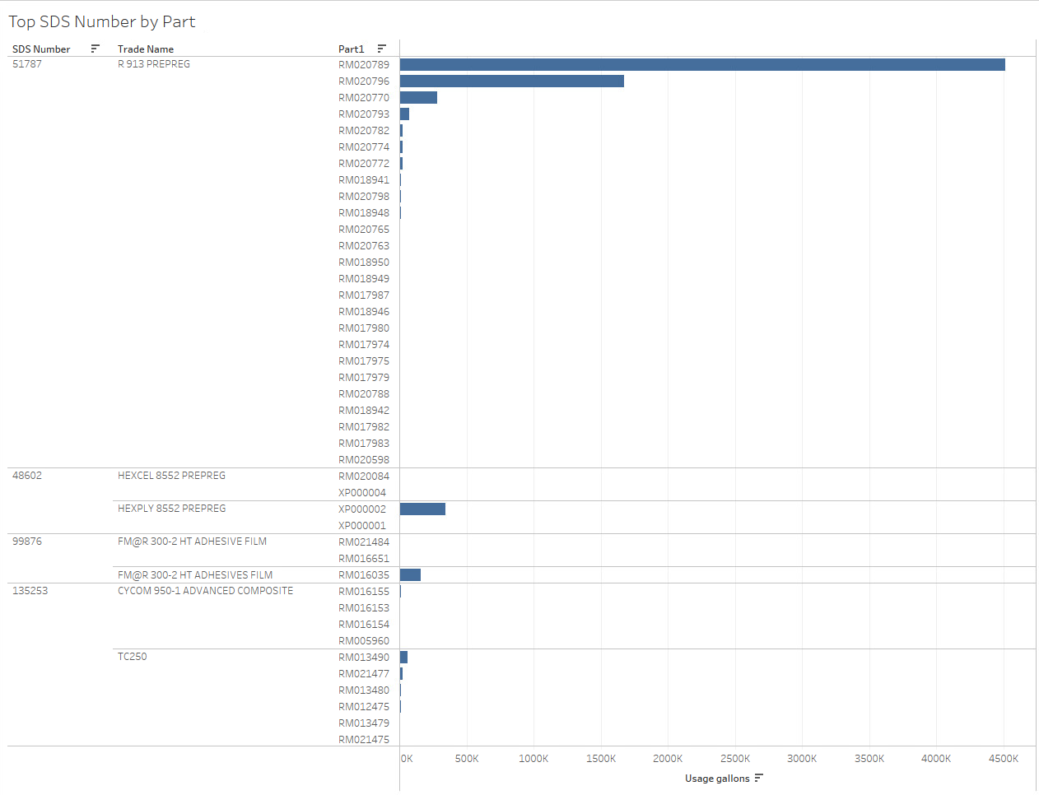
Data Preprocessing – Basic EDA
Top SDS Number by Trade Name and Part:
We were able to take the usage gallons and break it down by SDS number first, then Trade Name, and then lastly by Part.
Most Common:
- SDS Number: 51787
- Trade Name: R 913 PREPREG
- Part: RM020789

Slide 11
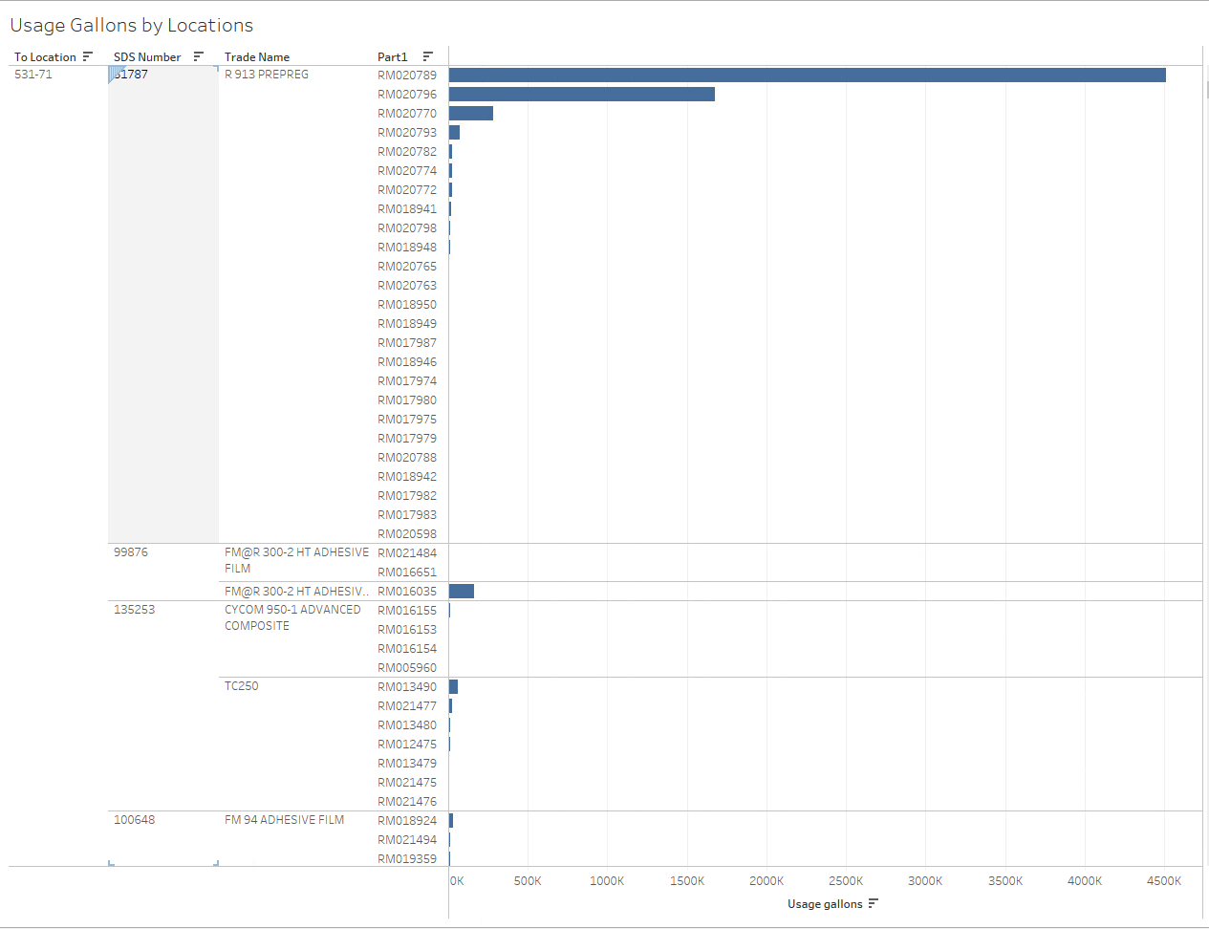
Data Preprocessing – Basic EDA
Usage Gallons by Locations:
This is very similar to the last visualization, the only difference here is knowing the location that the chemicals/parts were sent to. Ideally, we would have the organization name associated here but we did not have the information.
Notes:
Arunima

Slide 12
Models and Evaluations
Used 2 similar forecasting models – ARIMA and SARIMA
Noticed that the month of May 2022 was incomplete and skewing our data, so we removed that information
Used a monthly frequency
Weekly or Daily frequency would cause too much noise in our graphs
Used only 2 variables: Usage_gallons and TRANSACTION_DATE
Notes:
Sohrab

Slide 13
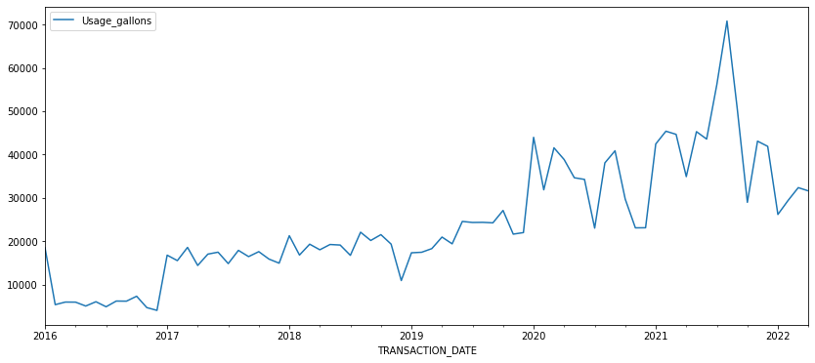
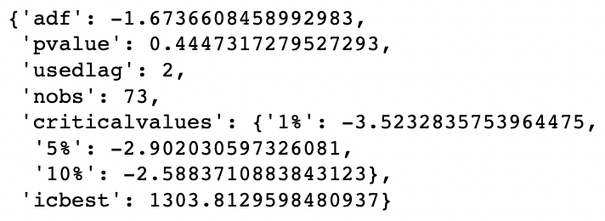
Models and Evaluations - ARIMA
Check for seasonality/
if stationary
Got initial idea of trends in data after final round of data manipulation
Used Augmented Dickey-Fuller (ADF):
If p-value < 0.05: stationary
If p-value > 0.05: not stationary
Result: Data is not stationary, must use differencing
Notes:
Sohrab

Slide 14
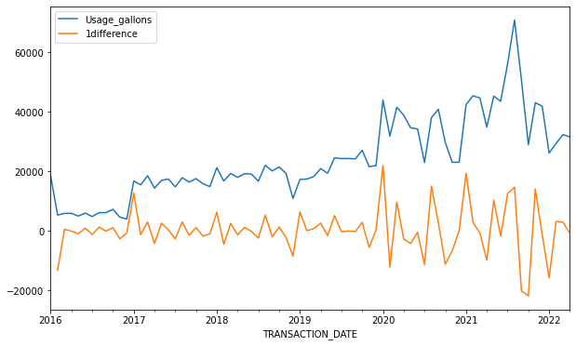
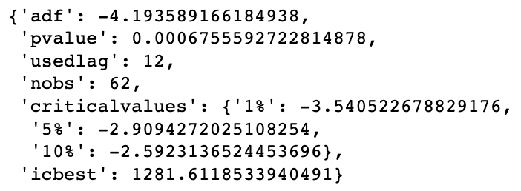
Models and Evaluations - ARIMA
Check for seasonality/
if stationary again
Since the data was not stationary, needed to do a round of differencing and then conduct another ADF test.
Round 2 of ADF Test:
Data is stationary and ready for model testing
After differencing, we get a plot like this
Notes:
Sohrab

Slide 15
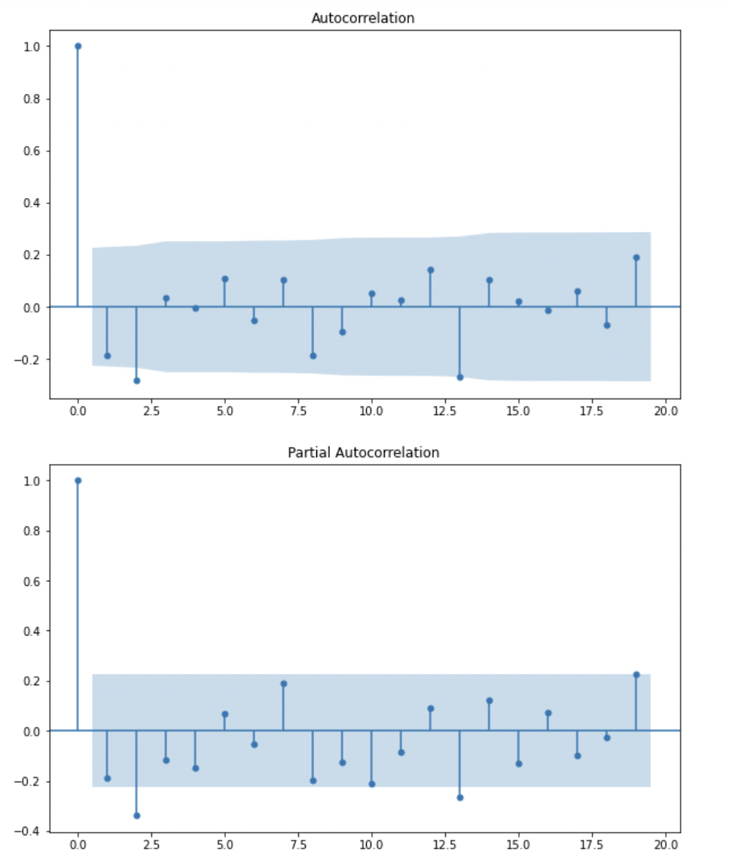
Models and Evaluations - ARIMA
Next, we run ACF and PACF tests to best determine our p, q, and d values.
We predict that the best model to use would be when:
p = 1
d = 1
q = 1
Notes:
Sohrab

Slide 16
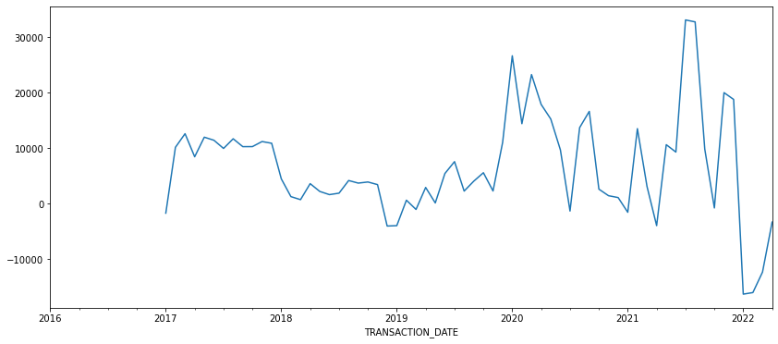
Models and Evaluations - SARIMA
The steps needed to creating a good model is a similar process to how we evaluated ARIMA
Where it differs is when we recognize seasonality and take the difference based on it.
We can see that there is a lag by an entire year
Notes:
Sohrab

Slide 17
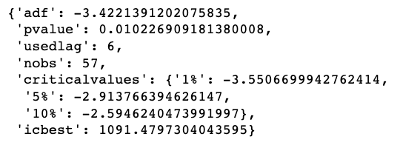
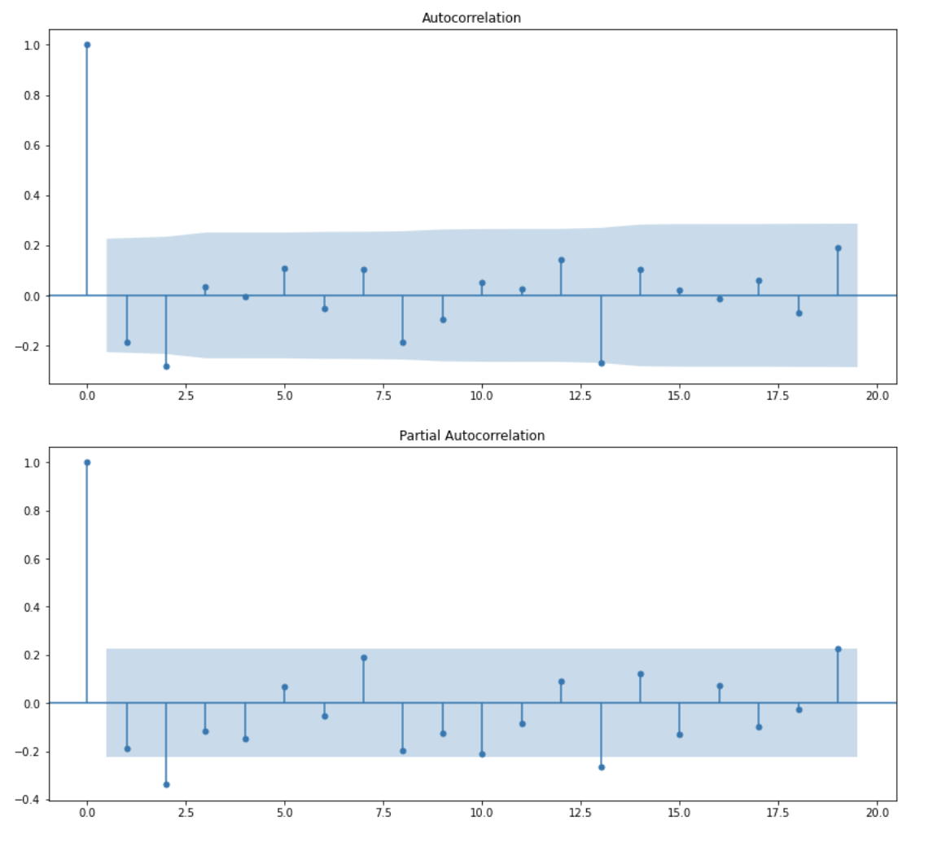
Models and Evaluations - SARIMA
After seasonality differencing, we again conduct the ADF test to check that the data is stationary
Then also run the ACF and PACF test to best determine our p, q, and d values.
p = 1, d = 1, and q = 1, P = 1, D = 1, Q = 0, and m = 12
Notes:
Sohrab

Slide 18
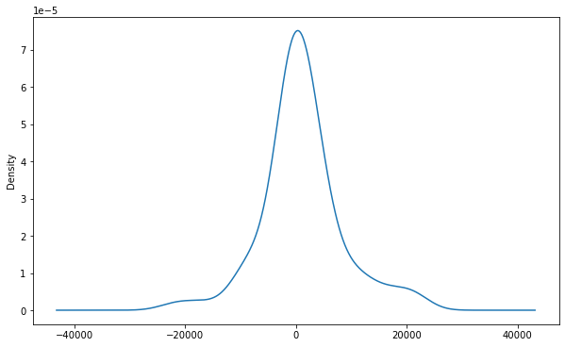
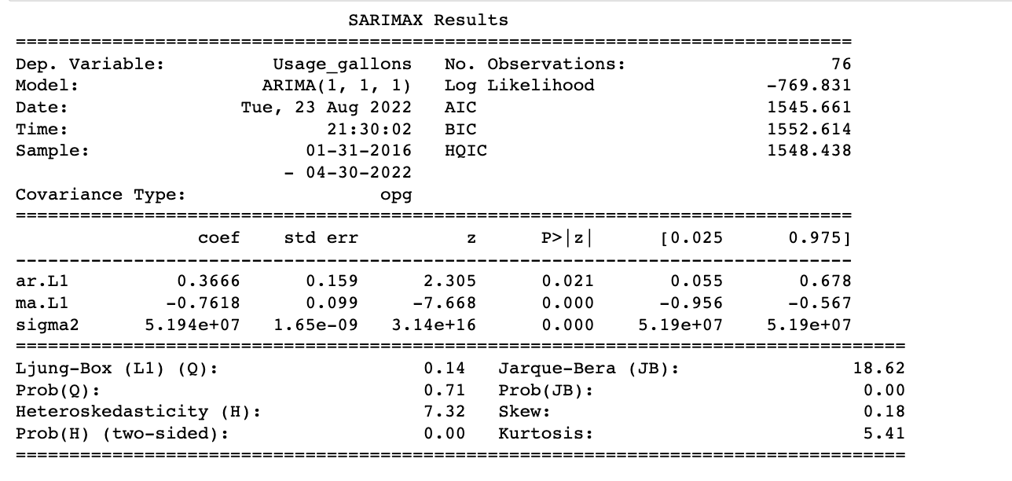
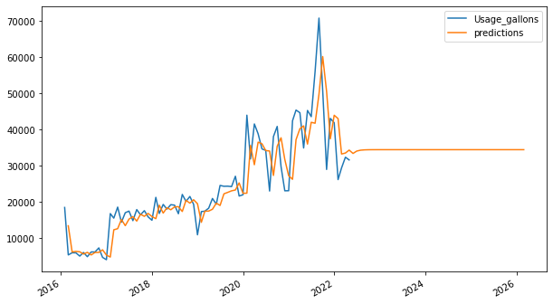
Interpretations and Analysis - ARIMA
Based on the numbers that we got in the evaluation, we determined that when p=1, d=1, and q=1, that we would find the best fit model.
Data had a normal distribution
An AIC value of 1545.661
The prediction graph however is not what we expected.
Notes:
Sohrab

Slide 19
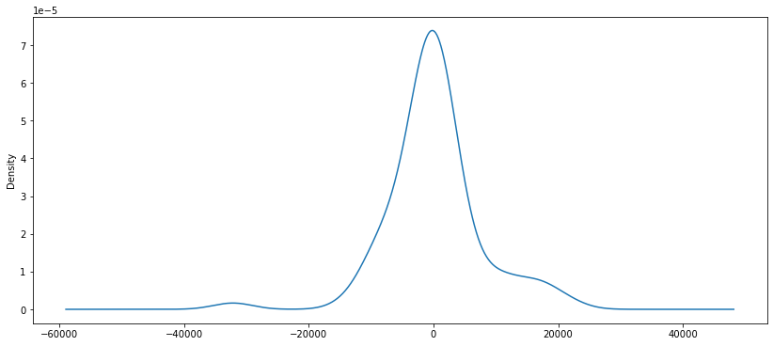
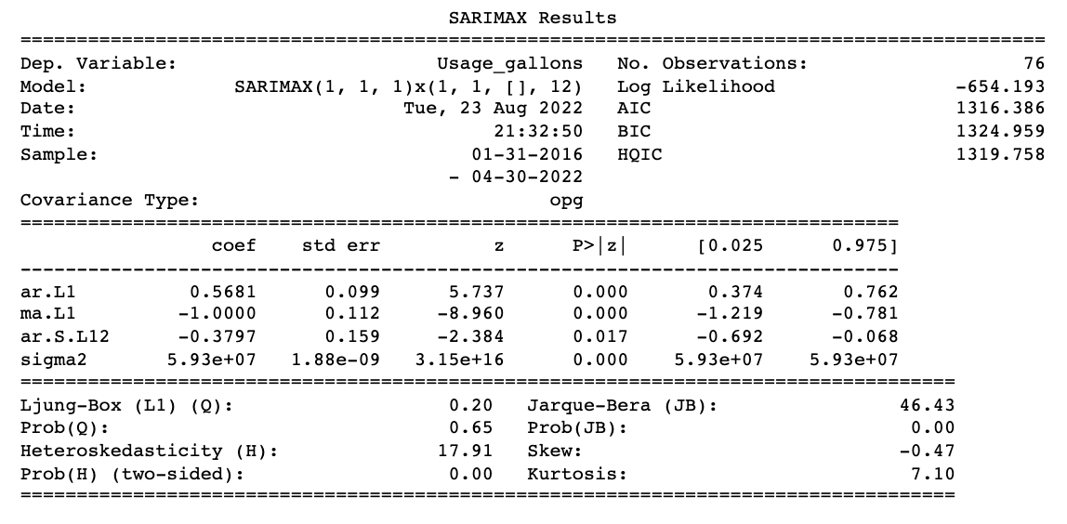
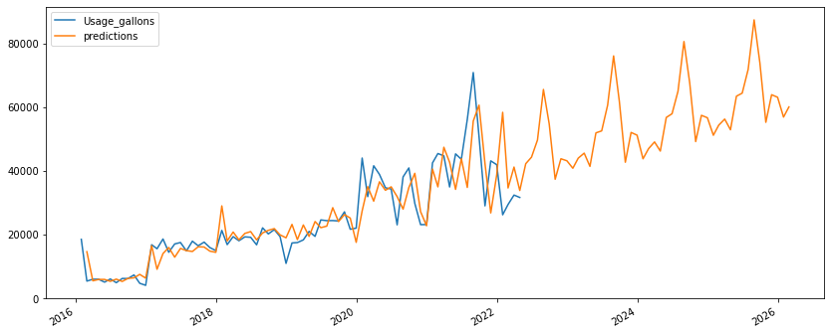
Interpretations and Analysis - SARIMA
Based on the numbers that we got in the evaluation, we determined that when p = 1, d = 1, and q = 1, P = 1, D = 1, Q = 0, and m = 12, that we would find the best fit model.
Data had a normal distribution
An AIC value of 1316.386, which is significantly lower than the ARIMA models (which was expected)
The prediction graph is giving us the seasonal spikes that we would expect, especially based on the historical data.
Notes:
Sohrab

Slide 20
Interpretations and Analysis Overall
SARIMA model is the better model to use over the ARIMA model
This process has evolved overall because we completely shifted our process and efforts to work on this forecasting objective that was different than our original goal of breaking down chemical consumption by organization
Limitations here:
Time: We could've explored the 'X' variable to understand how exogenous variables effect the model

Slide 21
Discussion
As mentioned before, we strongly believe that the SARIMA model is more effective and accurate at forecasting than the ARIMA model.
The whole process of evaluating the data (running an initial trend plot, ADF tests to check if stationary, running ACF/PACF tests) are crucial in figuring out our model parameters
One of the main measures that we are looking at is the AIC score. The lower number determines a model that best fits the data
ARIMA: 1545.661
SARIMA: 1316.386
Notes:
Arunima

Slide 22
Conclusion
Time series models are typically used for customer demand analysis (from a sales perspective) rather than for internal, inventory management.
Inventory management methods would be best in this use case to determine company usage in materials because those models are built on operation plans, materials, and stock.
However, with the data that was given to us, we had no other choice but to utilize a time series method.
Notes:
Tamlyn

Slide 23
Thank you!

Slide 24
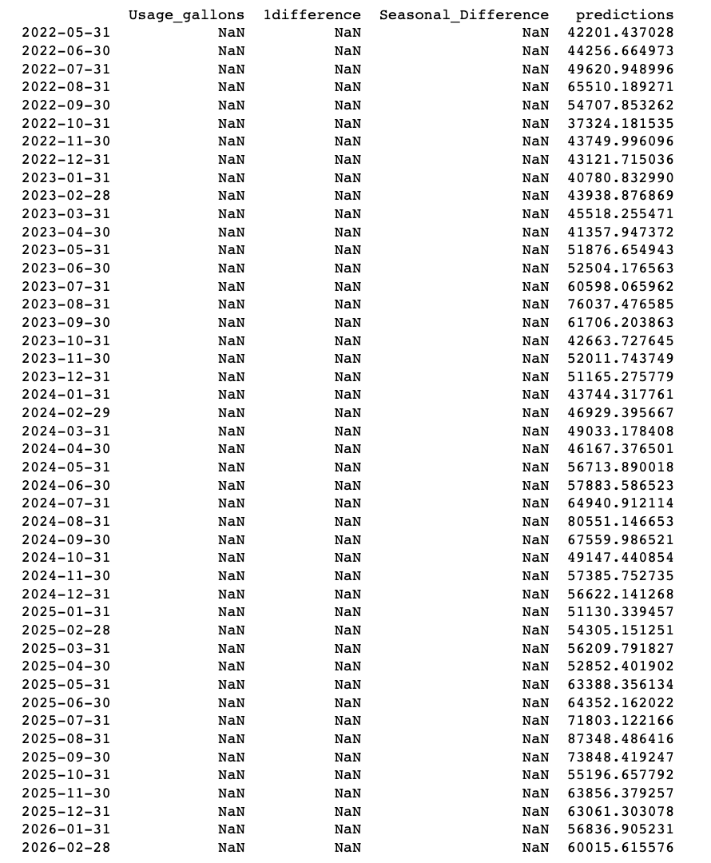
Appendix
Prediction values from SARIMA Model

Slide 25
References
Prabhakaran, S. (2022, March 8). ARIMA Model - Complete Guide to Time Series Forecasting in Python: ML+. Machine Learning Plus. Retrieved August 17, 2022, from https://www.machinelearningplus.com/time-series/arima-model-time-series-forecasting-python/​
Verma, Y. (2021, July 29). Complete Guide to SARIMAX in Python for Time Series Modeling. Analytics India Magazine. Retrieved August 17, 2022, from https://analyticsindiamag.com/complete-guide-to-sarimax-in-python-for-time-series-modeling/

